Slide 1
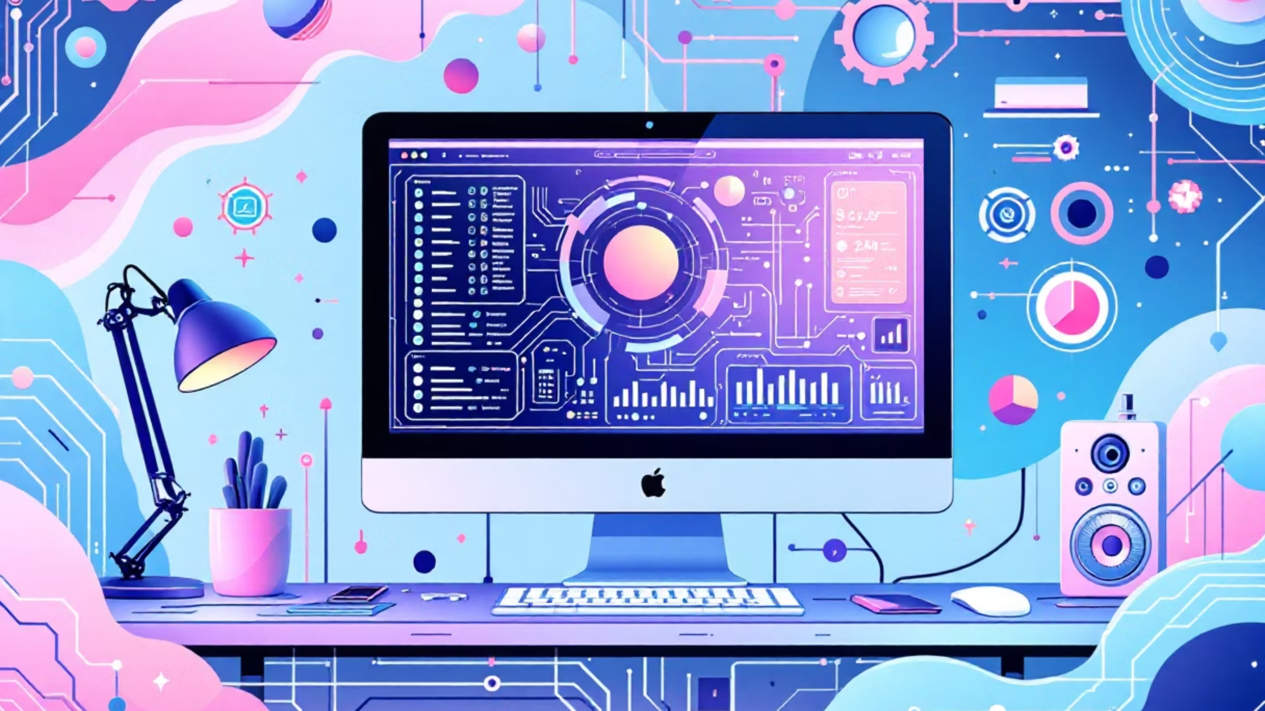
Computer Fundamentals
Presented by: Adarsh Pandey
MCA 1st Year
Subject: Fundamentals of Computer

Slide 2

What is a Computer?
An electronic device that processes data according to software instructions. It takes input, processes it with a CPU, stores information, and produces output to perform various tasks.

Slide 3




Types of Computers
Desktops
Laptops
Regular use, separate components (monitor, keyboard, mouse, CPU) mounted together.
Portable, all components integrated, great for on-the-go work with built-in features.
Servers
Tablets
Manage network resources, provide services like databases and application hosting.
More portable than laptops, touchscreens for browsing, content, and communication.
Other devices include smartphones, game consoles, and Smart TVs.

Slide 4
Computers by Functionality & Size
By Functionality
By Size
Analog Computers
Microcomputers
Data stored using continuous physical quantities (e.g., mechanical integrators).
Small, compact, for individual use (e.g., smartphones, desktops).
Minicomputers
Digital Computers
More powerful than microcomputers, used in mid-sized businesses (e.g., servers).
Most common, process data using discrete values (e.g., smartphones).
Hybrid Computers
Mainframe Computers
Combine analog and digital (e.g., complex medical equipment).
Used by large organizations for bulk data processing.
Supercomputers
Extremely powerful for complex calculations, research purposes.

Slide 5

Hardware vs. Software
Hardware
Software
Physical components you can touch and see. Performs tasks like storing data, processing information, and displaying results.
Set of instructions telling the computer what, when, and how to do tasks. Examples: MS Paint, WhatsApp, web browsers, games.
CPU: Executes instructions
Memory (RAM): Temporarily stores data
Storage Devices: Permanently store data
Input Devices: User interaction (keyboard, mouse)
Output Devices: Display results (monitors, printers)
Software converts input into machine-readable language for the CPU, which then produces output.

Slide 6
Core Components of a Computer
1
2
3
CPU (Central Processing Unit)
Motherboard
Memory (RAM)
The "brain" of the computer. Executes instructions, performs calculations, and handles tasks. Comprises ALU (Arithmetic Logic Unit) and CU (Control Unit).
Main circuit board connecting and enabling communication between all computer components.
Random Access Memory temporarily stores data for quick access while the computer is running.
4
5
Storage
Input/Output Devices
Includes HDDs and SSDs that store data permanently, even when the computer is off.
Input devices (keyboard, mouse) send data in; output devices (printer, speakers) display results.

Slide 7
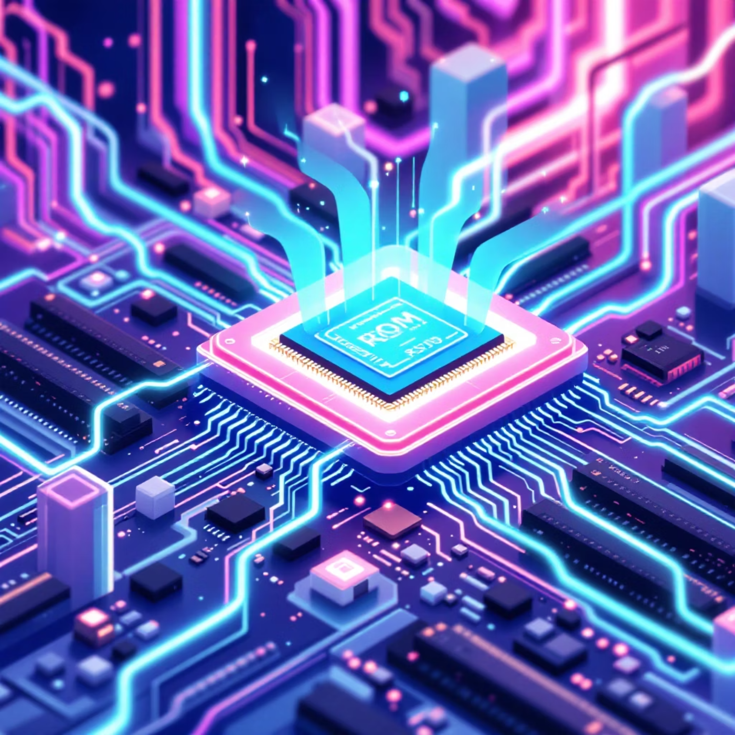
Computer Memory: Primary vs. Secondary
Primary Memory (Main Memory)
Stores data and instructions during operations. Uses semiconductor technology.
RAM (Random Access Memory): Volatile, temporary storage for active programs/data. Types: SRAM (faster), DRAM (slower, needs refreshing).
ROM (Read-Only Memory): Non-volatile, stores boot-up instructions and firmware. Types: PROM, EPROM, EEPROM.
Secondary memory is non-volatile, stores
large amounts of data permanently, and is
slower than primary memory.
Secondary memory is non-volatile, stores large amounts of data permanently, and is slower than primary memory.

Slide 8
Generations of Computers
1st Gen (1940-1956)
1
Vacuum tubes, massive, machine language, punch cards. (ENIAC, UNIVAC)
2
2nd Gen (1956-1963)
Transistors, smaller, faster, introduced programming languages (FORTRAN, COBOL).
3rd Gen (1964-1971)
3
Integrated circuits (IC), semiconductors, smaller, cheaper, accessible to wider audience.
4
4th Gen (1971-Present)
Microprocessors, portable, user-friendly, personal computers, networks. (IBM PC, Apple II)
5th Gen (Present & Beyond)
5
AI-based technology, quantum computing, nanotechnology, parallel processing. (Smartphones, Desktops)

Slide 9

Programming Languages & Processors
Programming Languages
Language Processors
Convert source code into machine code. Find errors during translation.
Set of instructions and syntax to create software. Key features include syntax, data types, variables, operators, control structures, libraries, and paradigms.
Compiler: Translates entire program at once (C, C++).
Assembler: Translates assembly language into machine code.
Examples: Python, Java, C++, JavaScript.
Interpreter: Translates and executes line by line (Python, Perl).

Slide 10



Algorithms: The Blueprint of Logic
What is an Algorithm?
Why are Algorithms Needed?
Key Characteristics
A finite sequence of clear, unambiguous steps to solve a specific problem.
Clear, well-defined inputs/outputs, finite, feasible, language-independent, effective.
Solve complex problems efficiently, automate processes, enable tasks impossible for humans.
Algorithms can be expressed in natural language, flowcharts, or pseudocode (a code-like structure in plain English).

Slide 11
Pseudocode: Translating Logic to Steps
Pseudocode serves as a bridge between human language and programming language. It offers a detailed, step-by-step description of an algorithm's logic using plain English and a code-like structure, making it understandable for both developers and non-technical stakeholders.
Organize Tasks & Set Goals
Use Standard Structures
Clearly sequence tasks and state the main objective of the pseudocode at the outset.
Employ common programming constructs like IF-ELSE, FOR, and WHILE. Indent for readability.
Naming & Keywords
Clarity & Simplicity
Use simple, distinct naming conventions. Represent reserved keywords (e.g., IF, WHILE) in CAPITAL LETTERS.
Ensure the pseudocode is finite, clear, and easy to understand for any audience, avoiding technical jargon.

Slide 12

Thank You!
Questions?

